Slide 1
Bags
(accessories)

Slide 2
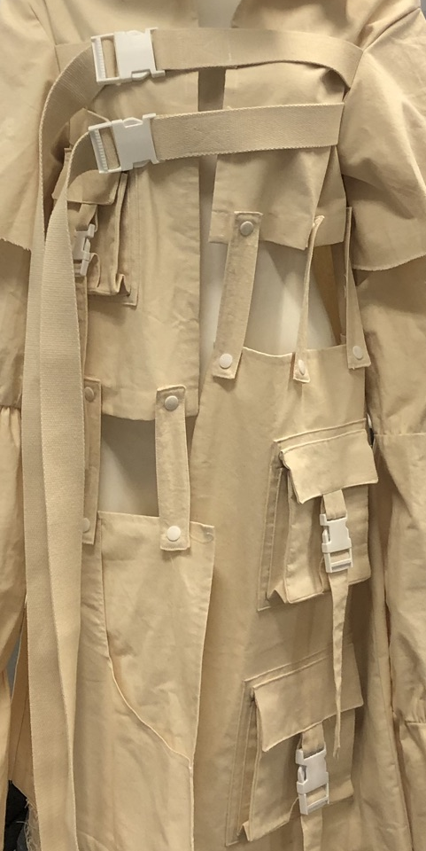
Accessories / hardware for bags
Sketchbook and research log by HKDI Fashion design graduate CHAN Leo recording his initial idea and concept during his research and development stage.
Bag closures
Zips
Frames
Buckles
Drawstrings
Locks
Attachments
(Connect the handle or straps to the bag)
D-rings
O-rings
H-rings
Square rings
Dog clips
Reinforcements
Rivets
Stands
Collection by ZHENG Siyi, HD in Fashion Design, Hong Kong Design Institute
Photo(s) is/are provided by HKDI

Slide 3
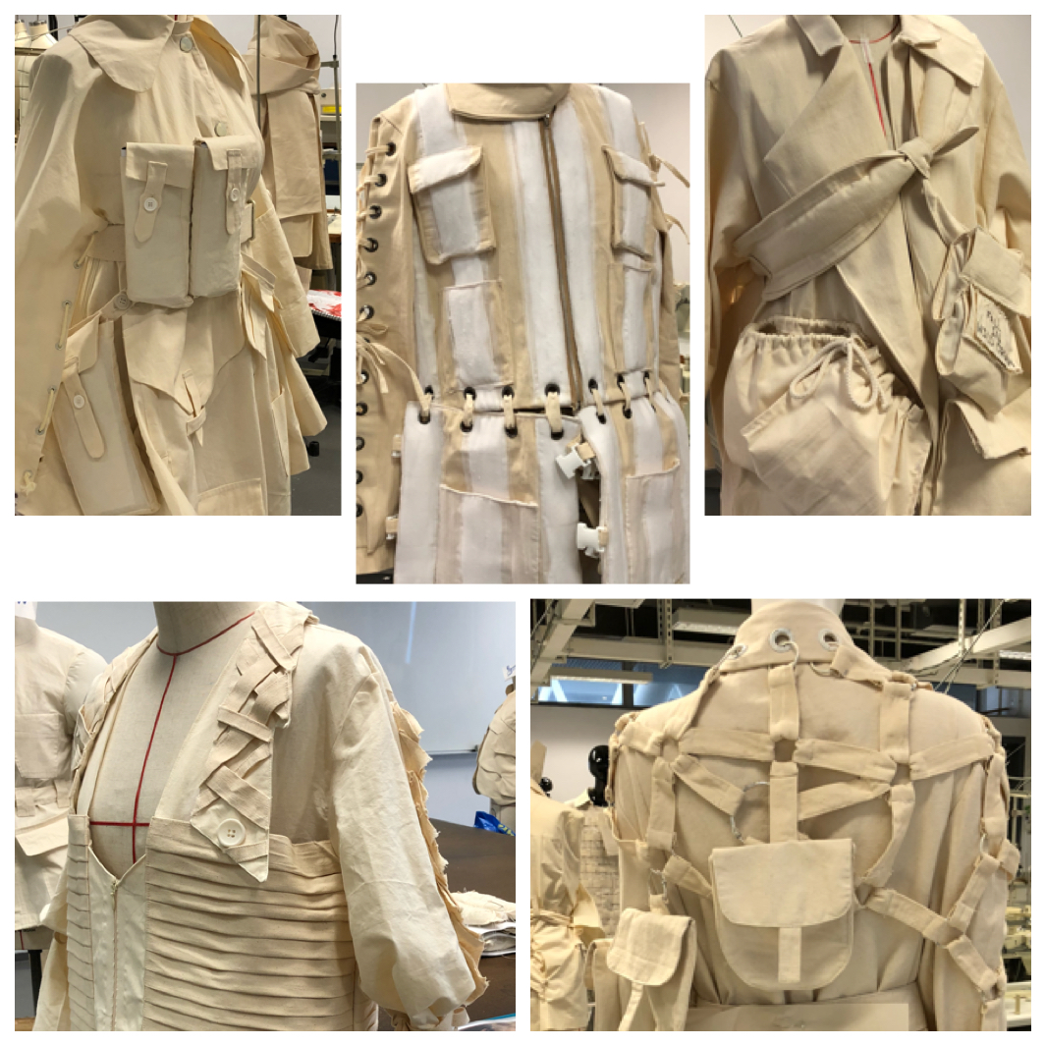
Accessories / hardware for bags
Sketchbook and research log by HKDI Fashion design graduate CHAN Leo recording his initial idea and concept during his research and development stage.
Handles
Chains
Adjusters
Eyelets
Cord locks
Photo(s) is/are provided by HKDI

Slide 4
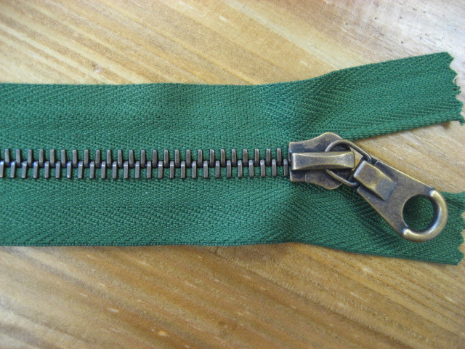
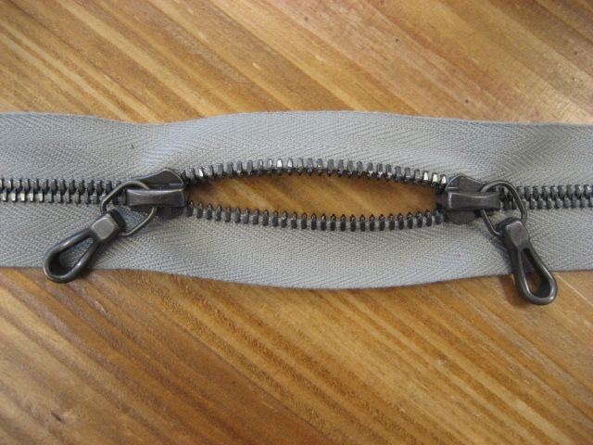
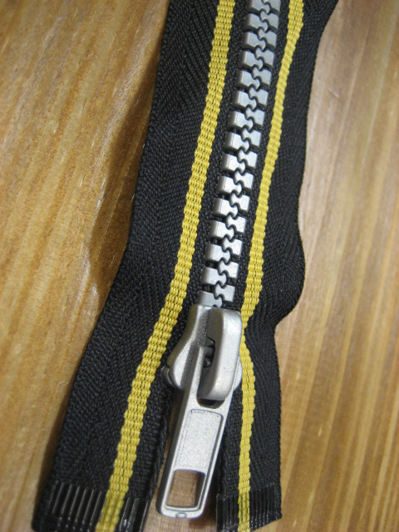
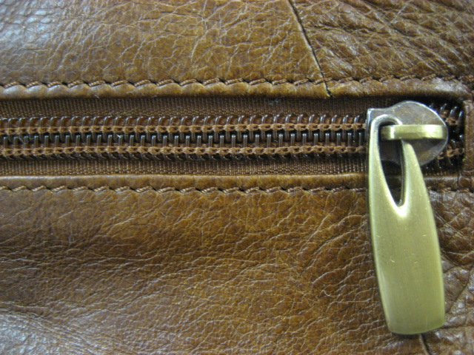
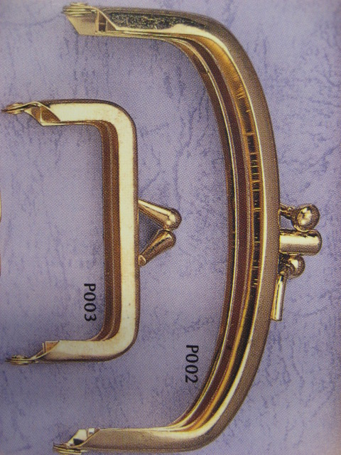
Bag closures
Metallic Zipper
Sketchbook and research log by HKDI Fashion design graduate CHAN Leo recording his initial idea and concept during his research and development stage.
Zippers
Frames
Plastic Zipper
Metallic Frames
Photo(s) is/are provided by HKDI

Slide 5
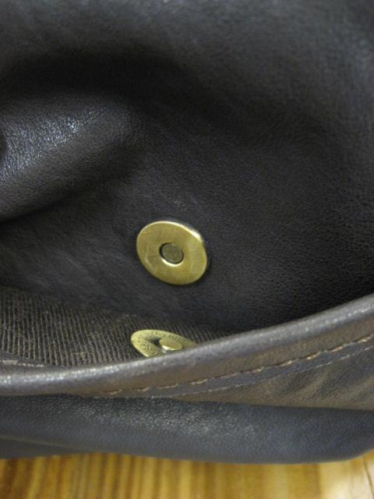
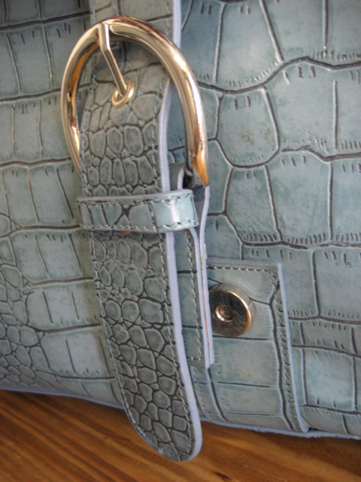
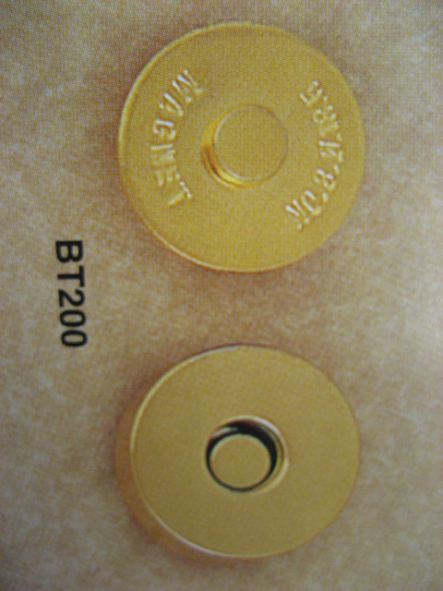
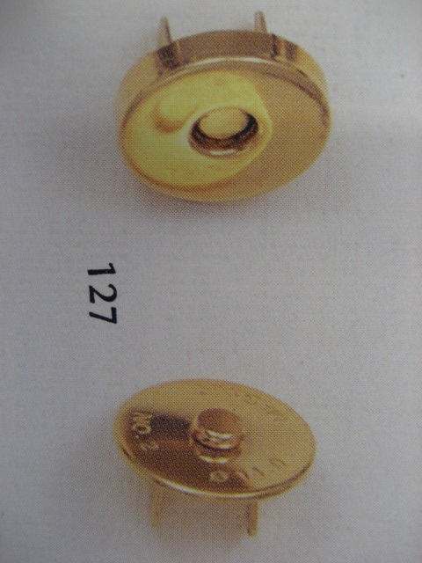
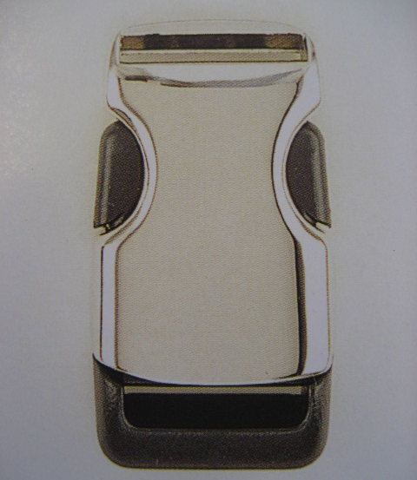
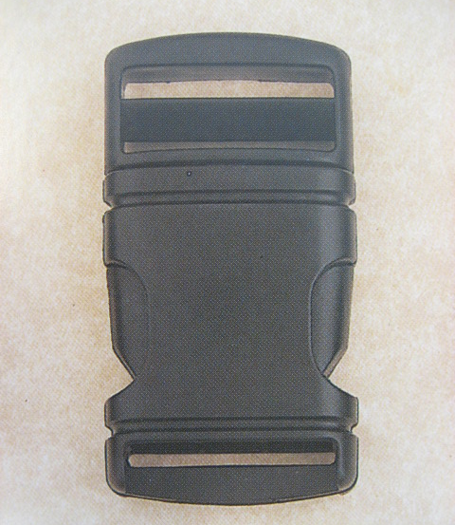
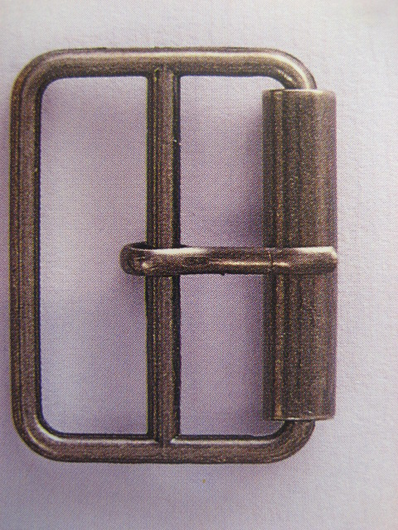
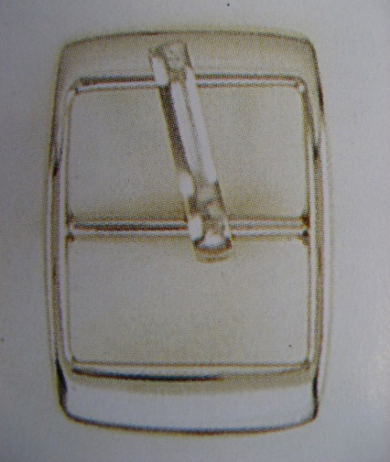
Bag closures
Sketchbook and research log by HKDI Fashion design graduate CHAN Leo recording his initial idea and concept during his research and development stage.
Metal/Magnetic Buckle
Buckles
Strap Locks
Belt Buckle
Photo(s) is/are provided by HKDI

Slide 6
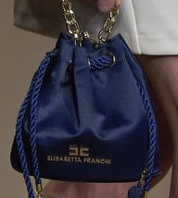
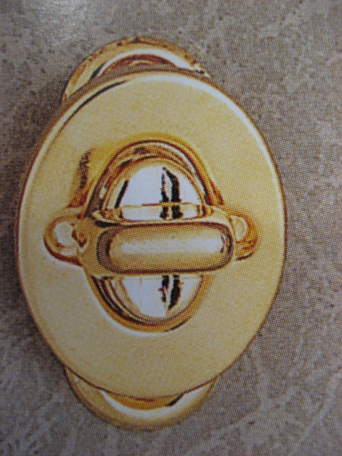
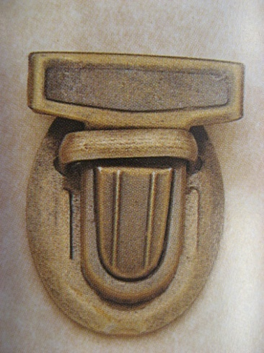
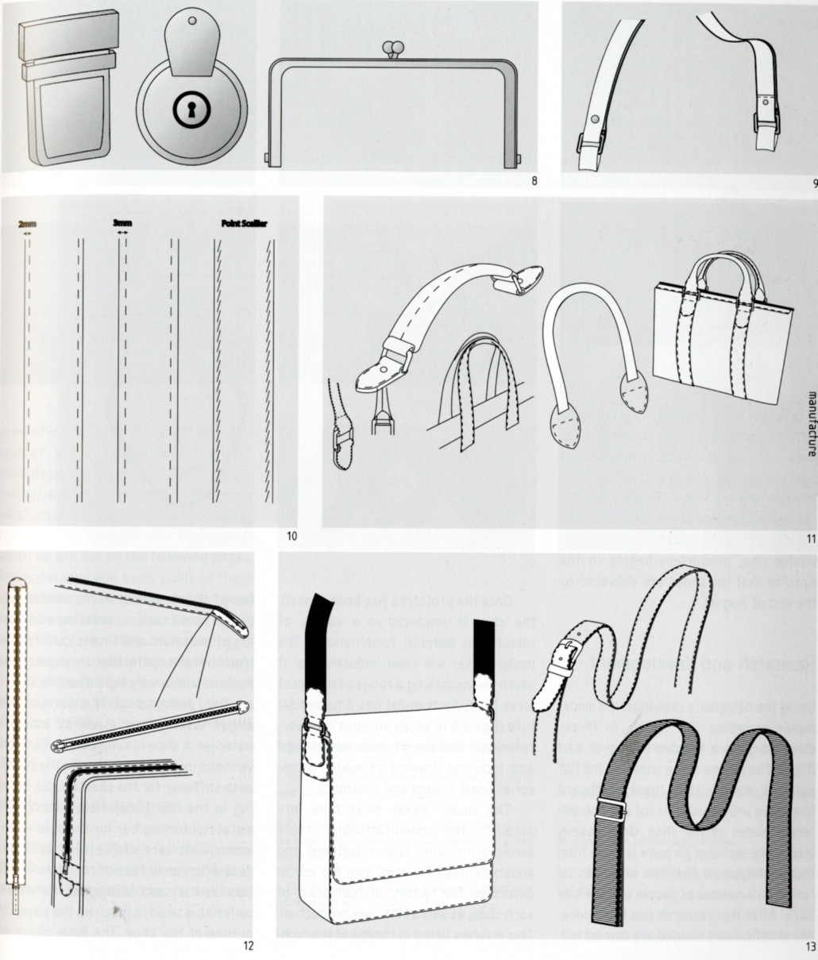
Bag closures
Sketchbook and research log by HKDI Fashion design graduate CHAN Leo recording his initial idea and concept during his research and development stage.
Drawstrings
Locks
Drawstring
Locks
Photo(s) is/are provided by HKDI
Source from royalty free photo from Pinterest

Slide 7
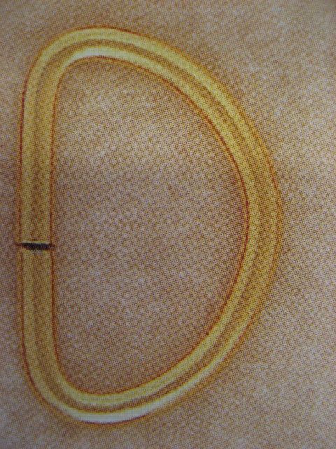
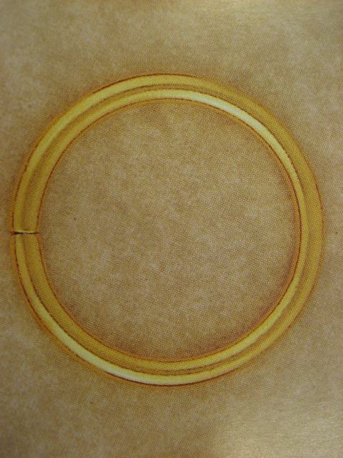
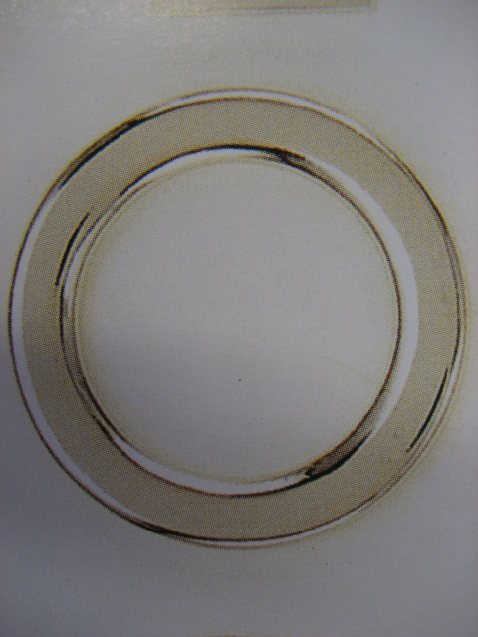
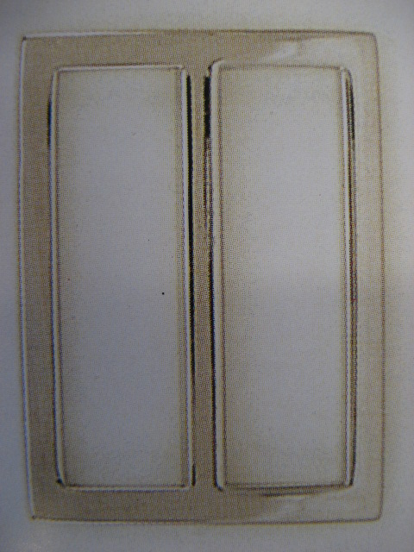
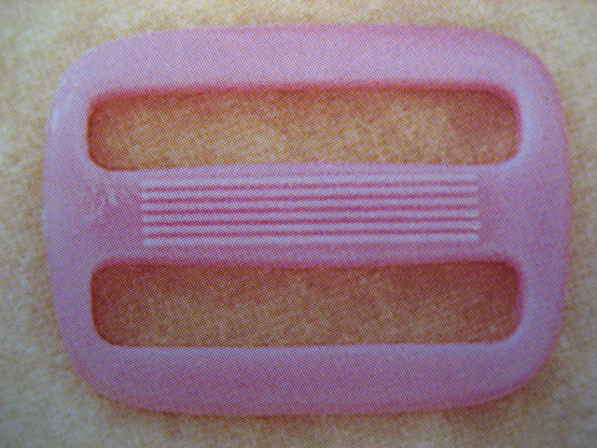
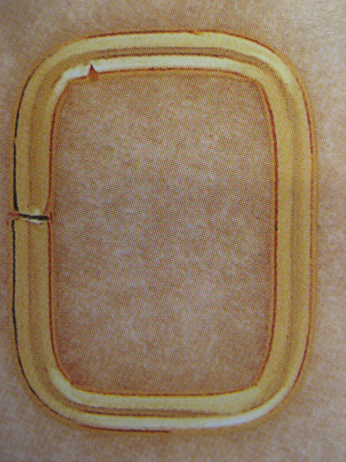
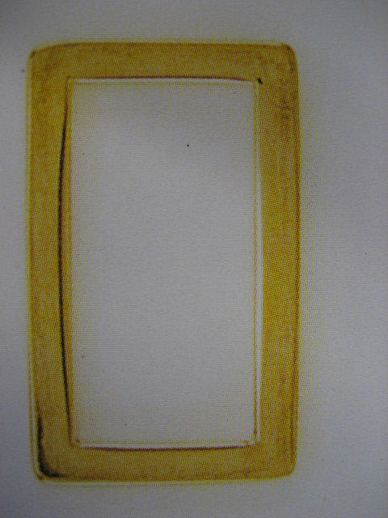
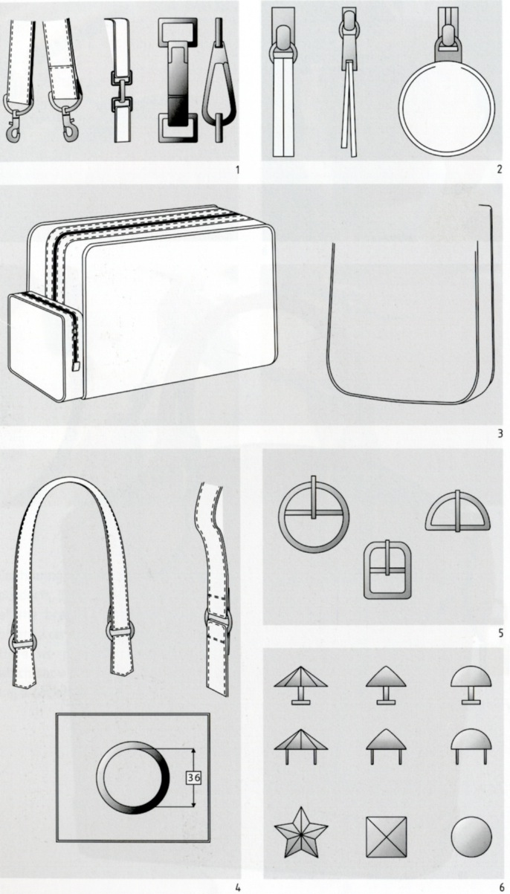
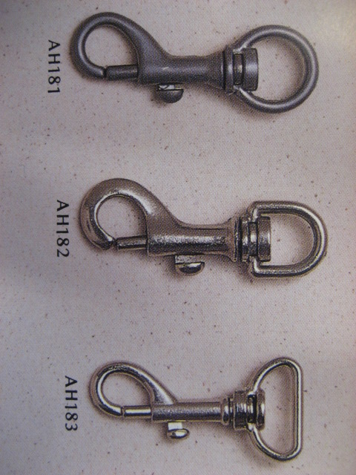
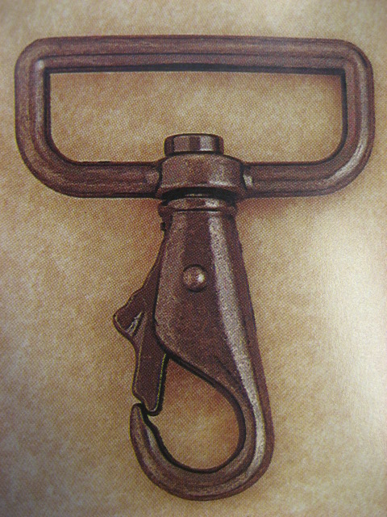
Attachments
D-rings
O-rings
H-rings
Square rings
Connect the handle or straps to the bag, available in a wide variety of materials, sizes and finishes.
Dog Clips
Photo(s) is/are provided by HKDI

Slide 8
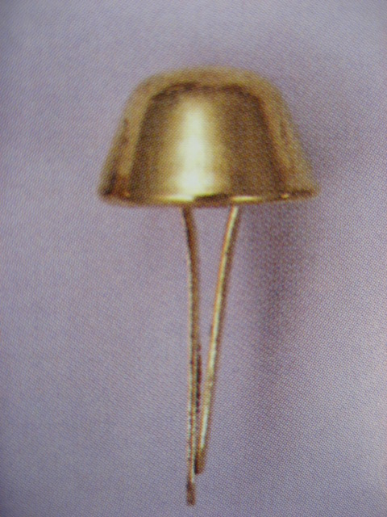
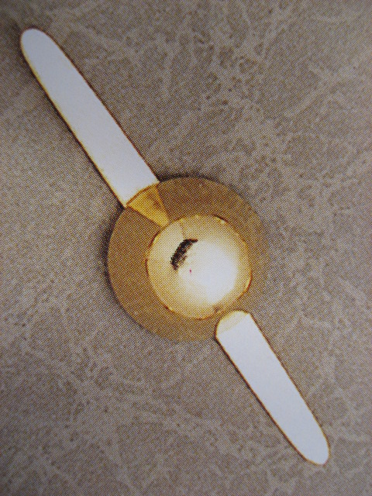
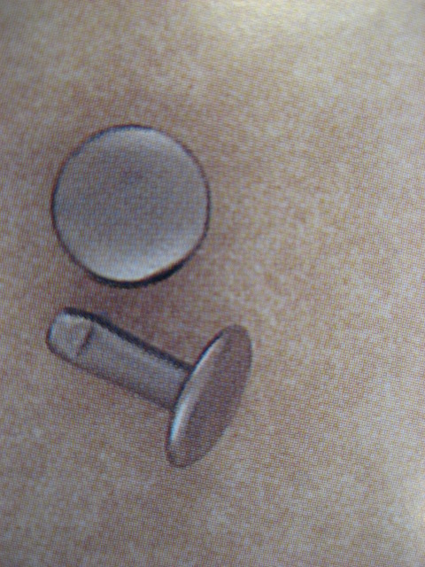
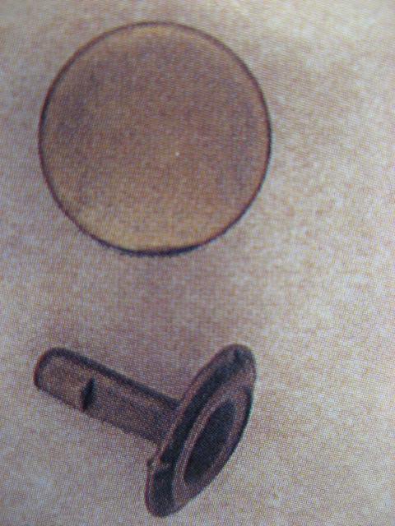
reinforcements
Bottom Stands
Rivets
Photo(s) is/are provided by HKDI

Slide 9
Handle and strap
Photo(s) is/are provided by HKDI

Slide 10
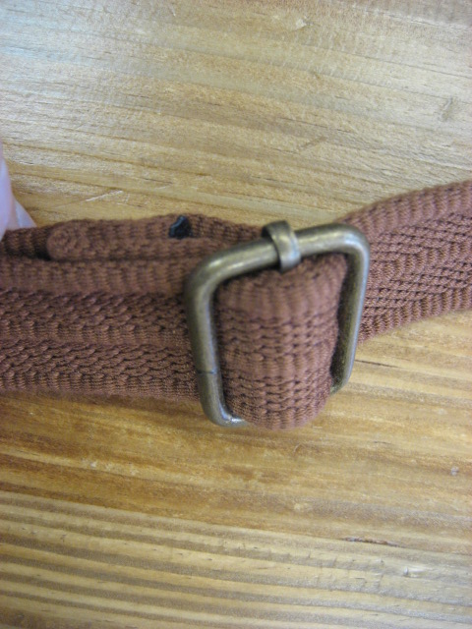
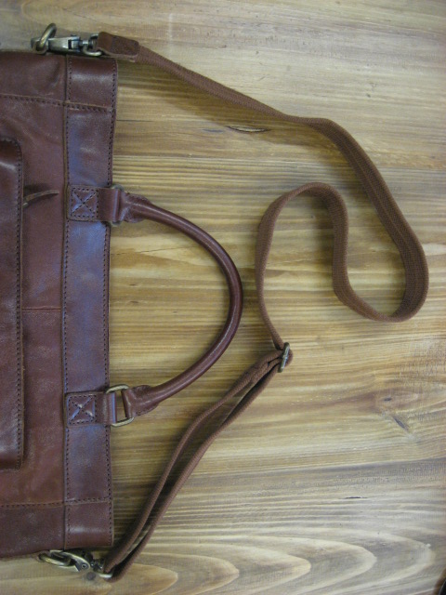
Handle and strap
Photo(s) is/are provided by HKDI

Slide 11
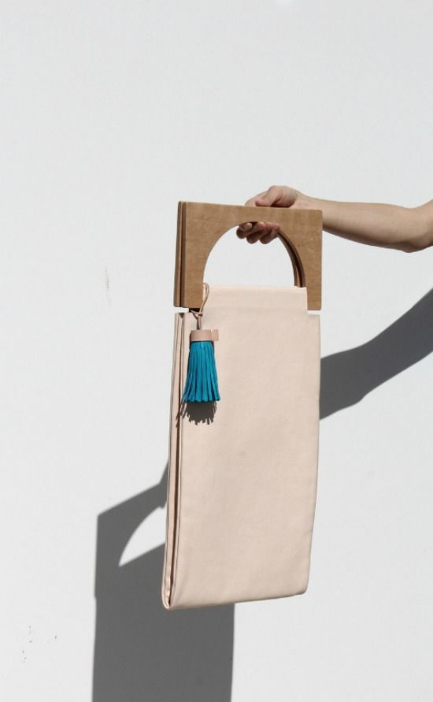
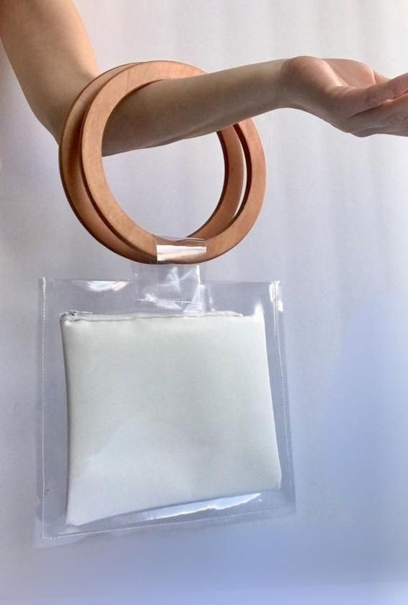
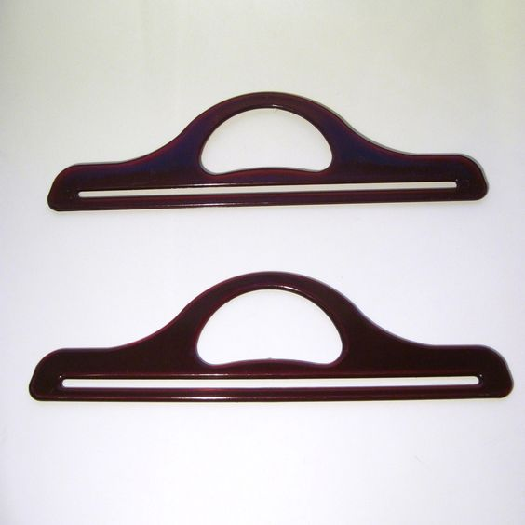
Handles
Source from royalty free photo from Pinterest

Slide 12
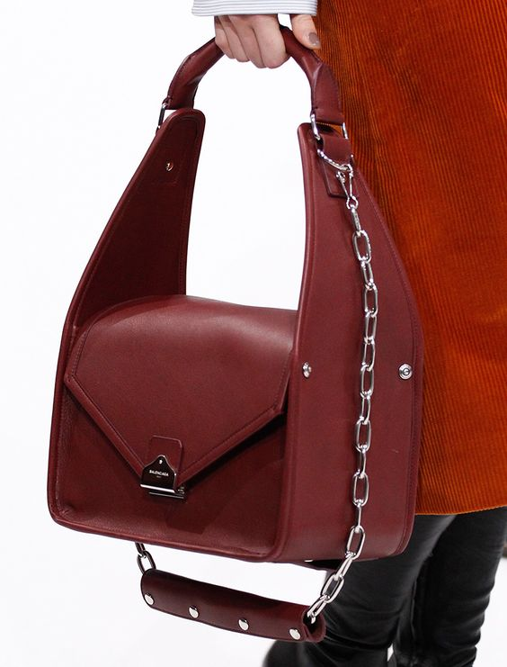
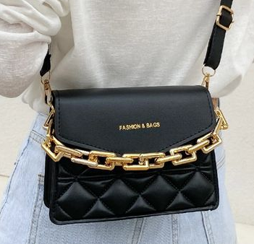
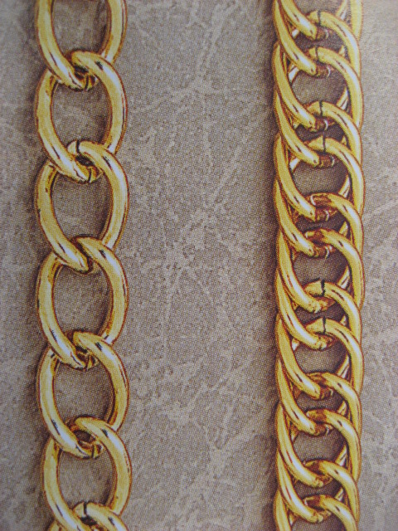
Chains
Source from royalty free photo from Pinterest

Slide 13
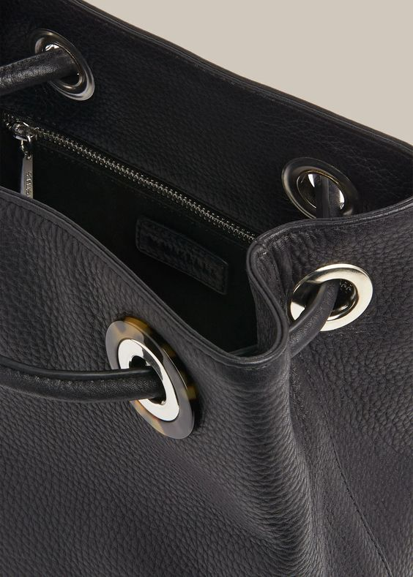
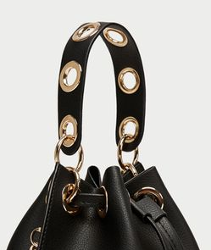
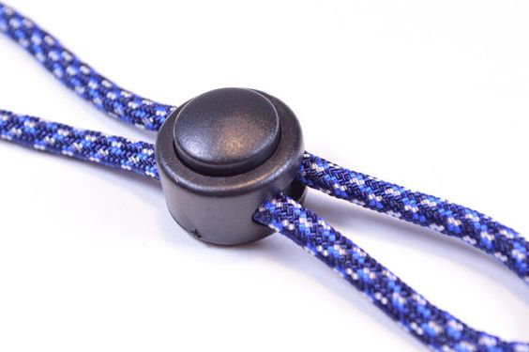
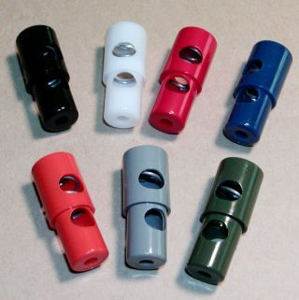
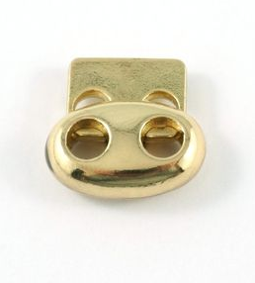
Adjusters
Eyelets
Cord locks
Source from royalty free photo from Pinterest

Slide 14
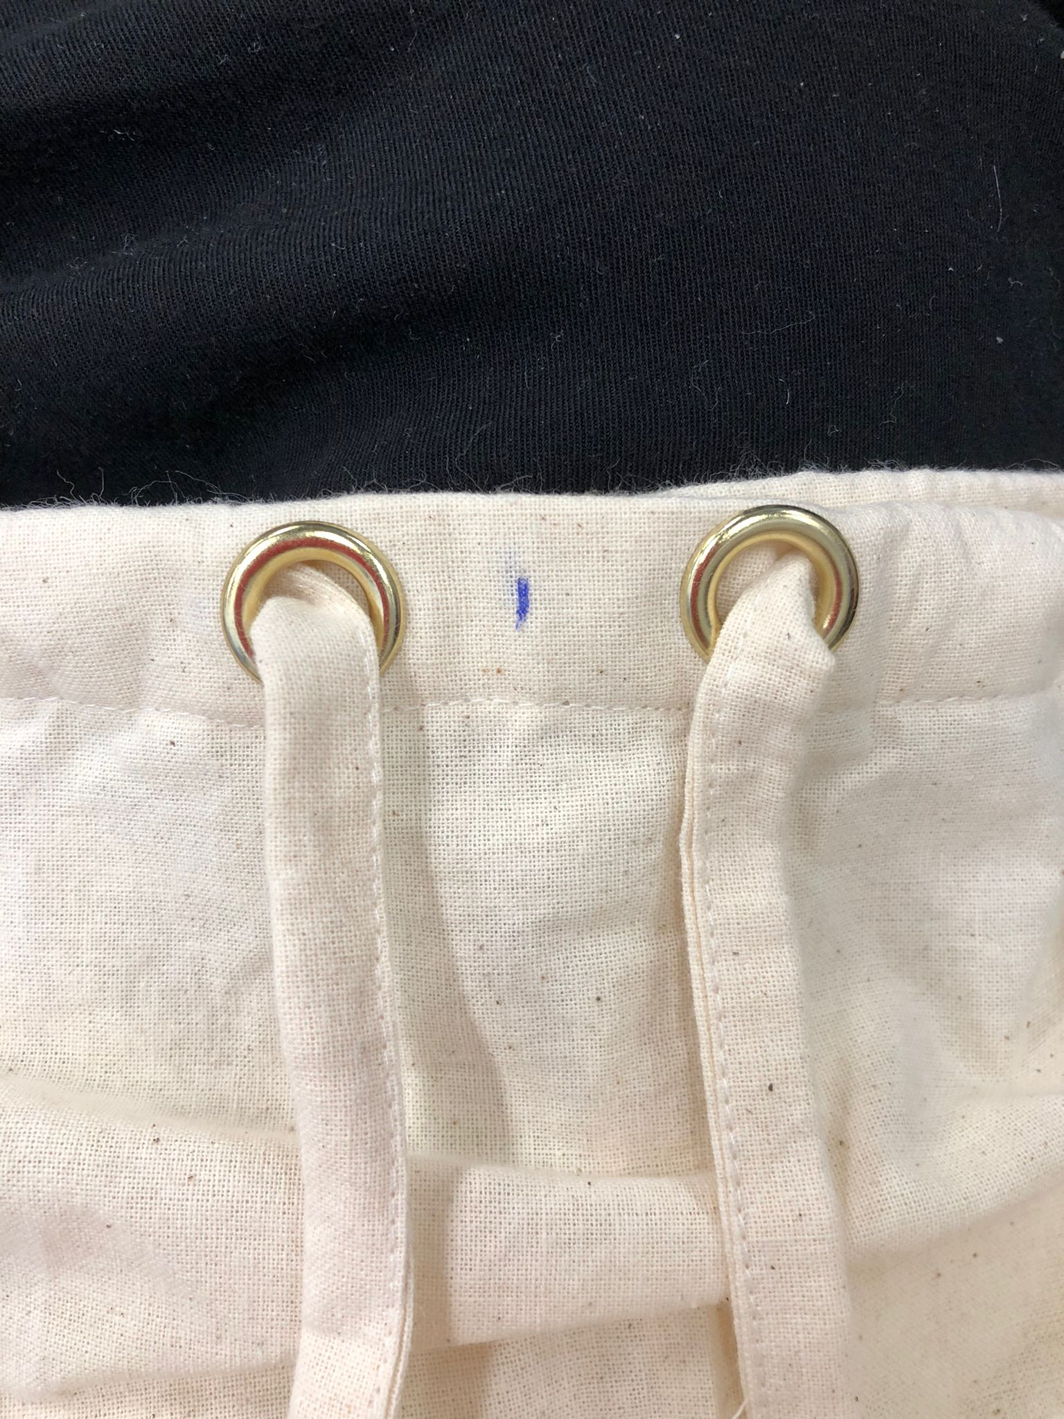
Demonstration video
Attaching eyelet

Slide 15
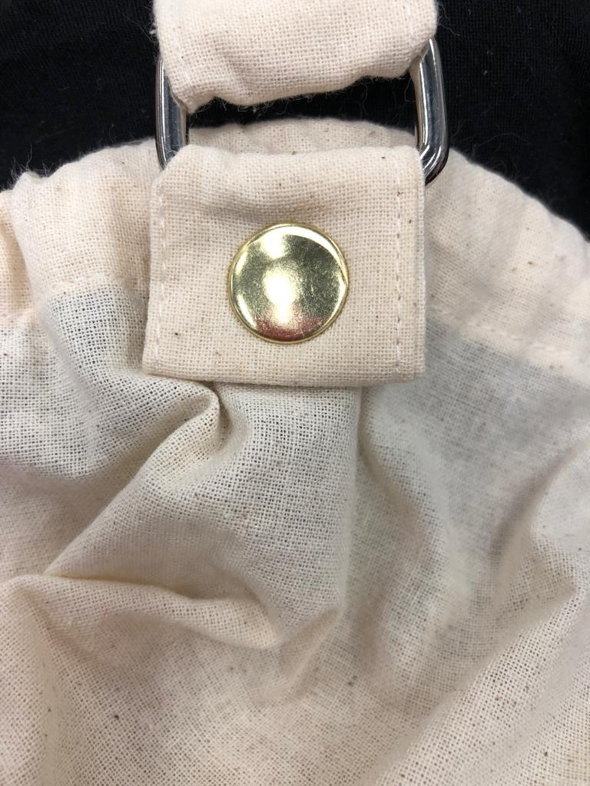
Demonstration Video
Attaching rivet

Slide 16
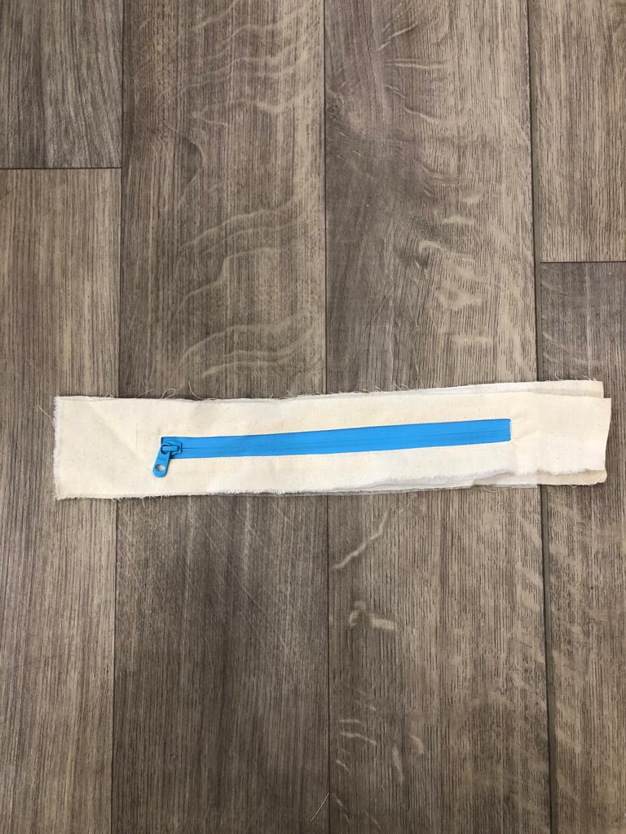
Demonstration video
Attaching zipper

Slide 17
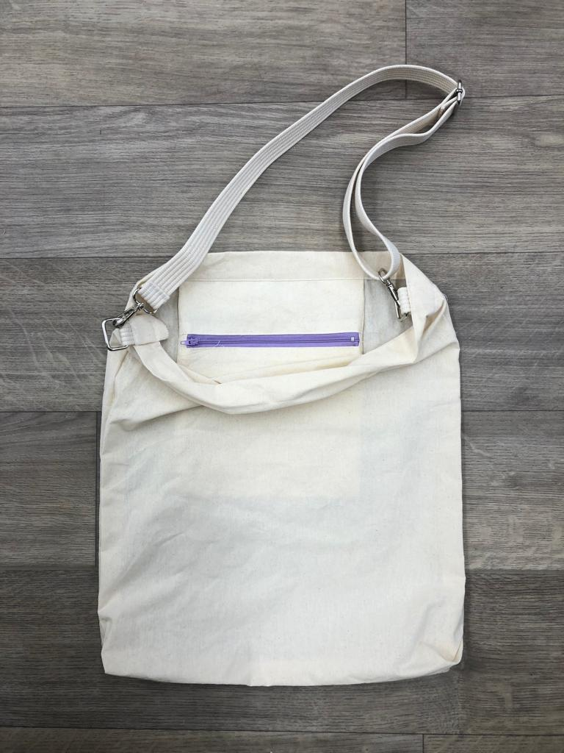
Demonstration video
Attaching zipper @ inner bag

Slide 18



Adjustable strap
Photo(s) is/are provided by HKDI

Slide 19



Demonstration video
Attaching adjustable strap
Photo(s) is/are provided by HKDI
Photo(s) is/are owned and provided by HKDI

